Slide 1
Python Course Phase-02
Peoples’ Information Technology Program (PITP)
An Initiative by Information Science & Technology Department,
Government of Sindh
By: Engr. Asif Ali

Slide 2

About Instructor
Who am I?

Slide 3
I don’t know about you!!!
Name?
Hometown?
Experience in IT?
Field of interest in CS (e.g. ML, Network, Security, etc.)
Expectation from this course?
Now its time to introduce yourself
☺

Slide 4

About Course!

Slide 5
About Python Course
Introduction to Python Basics and Control Flow.
Lists, Loops, and Basic Operations.
Functions and Data Structures.
File Handling and project structuring.
Data Visualization and advanced features.
Project finalization and deployment.

Slide 6
Recommended Books
1. Python Crash Course (2nd Edition) – by Eric Matthes
o Description: A hands-on, project-based introduction to Python. This book is ideal for beginners and covers essential programming concepts using real-world projects.
o Publisher: No Starch Press
o ISBN: 978-1593279288

Slide 7
Recommended Books
2. Automate the Boring Stuff with Python – by Al Sweigart
o Description: This book focuses on automating everyday tasks using Python. It’s suitable for both beginners and intermediate learners looking to apply Python in practical scenarios.
o Publisher: No Starch Press
o ISBN: 978-1593279929

Slide 8
Recommended Books
3. Python for Data Analysis (2nd Edition) – by Wes McKinney
o Description: A comprehensive guide to using Python for data analysis, including an introduction to libraries such as Pandas, NumPy, and Matplotlib.
o Publisher: O'Reilly Media
o ISBN: 978-1491957660

Slide 9
Online Resources
1. W3Schools – Python Tutorial
o URL: w3schools.com/python
o Description: A great beginner-friendly resource that offers interactive tutorials on basic Python concepts, control flow, data structures, and more

Slide 10
Online Resources
2. Learn Python – Python.org
o URL: docs.python.org/3/tutorial
o Description: The official Python documentation provides a thorough tutorial covering everything from Python syntax to advanced concepts such as object-oriented programming.

Slide 11
Online Compilers
Python Compiler

Slide 12
Marks Breakdown
SNO | Activity | Marks
1. | Mid-Term Exam | 30 Marks
2. | Project | 30 Marks
3. | Final-Term Exam | 30 Marks
4. | Online Earning | 10 Marks

Slide 13
My Rules
Ask questions (Through Discussion Forums), Feel free to ask any question
If you have any question during class raise your hand first and then ask question
Don’t take notes, these slides will be provided.
Correct me if I make a mistake (remember I am in continuous learning mode)
Respect to other’s opinion in class
No cross-talk during class
5 minutes late comers will have to pay penalty of Rs. 100.
Finally – use of mobile phones in class is strictly prohibited without permission.

Slide 14
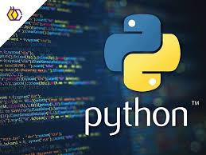
Python

Slide 15
Agenda
Introduction to Python Programming
Why Python Programming?
Comparision of Python Programming with other programming languages.
Installation of Python Programming.
First program in Python
Variables and keywords.
Data Types
User-defined Input
Operators
Tasks

Slide 16
Python
High Level programming.
Easy syntax
Cross platform
Applications

Slide 17
Brief History of Python
Invented in the Netherlands, early 90s by Guido van Rossum Named after Monty Python
Open source
Considered a scripting language, but it is much more Object Oriented.
Used by Google from the beginning increasingly popular

Slide 18
Why Python Programming
??

Slide 19
10 reasons why Python?
1. Easy to understand
No brackets
Simple Code

Slide 20
10 reasons why Python?
2. Mature and supportive Python Community
Documentation

Slide 21
10 reasons why Python?
3. Support from Renowed Corporate Sponsors
Facebook
Amazon
Google

Slide 22
10 reasons why Python?
4. Hundreds of Python Libraries and Frameworks
Numpy
Matplotlib
Django

Slide 23
10 reasons why Python?
5. Versatility, Effiency,Reliability,and Speed
Mobile Application
Desktop Application
Web Developement
Hardware Programming

Slide 24
10 reasons why Python?
6. Big Data, Machine Learning, and Cloud Computing
OpenCV for Computer Vision
Tensorflow for Neural Network

Slide 25
10 reasons why Python?
7. First Choice Language
Simple
User-friendly
Easy to understand

Slide 26
10 reasons why Python?
8. The flexibility of Python Language

Slide 27
10 reasons why Python?
9. Use of Python in Academics
Artificial Intelligence
Deep Learning
Machine Learning

Slide 28
10 reasons why Python?
10. Automation
Sending out, replying to, and sorting emails
Filling out PDFs and Excel files
Sending HTTP requests
Performing quick math equations
Calculating exchange rates

Slide 29
Comparision of Python with other programming languages.
1. C
2. C++
Java
PHP

Slide 30
Hello World Program in C
#include <stdio.h> int main() {
// printf() displays the string inside quotation printf("Hello, World!");
return 0;
}

Slide 31
Hello World Program in C++
// Your First C++ Program #include <iostream>
int main() {
std::cout << "Hello, World!"; return 0;
}

Slide 32
Hello World Program in Java
// Your First Program class HelloWorld {
public static void main(String[] args) { System.out.println("Hello, World!");
}
}

Slide 33
<?php
echo "Hello, World!";
Hello World Program in PHP
?>

Slide 34
Hello World Program in Python
print(“Hello World”)

Slide 35
Output
Hello, World

Slide 36
Installation of Python
?
https://www.python.org/downloads/

Slide 37
First Program in Python
print(“Hello, I am Asif Ali”)

Slide 38
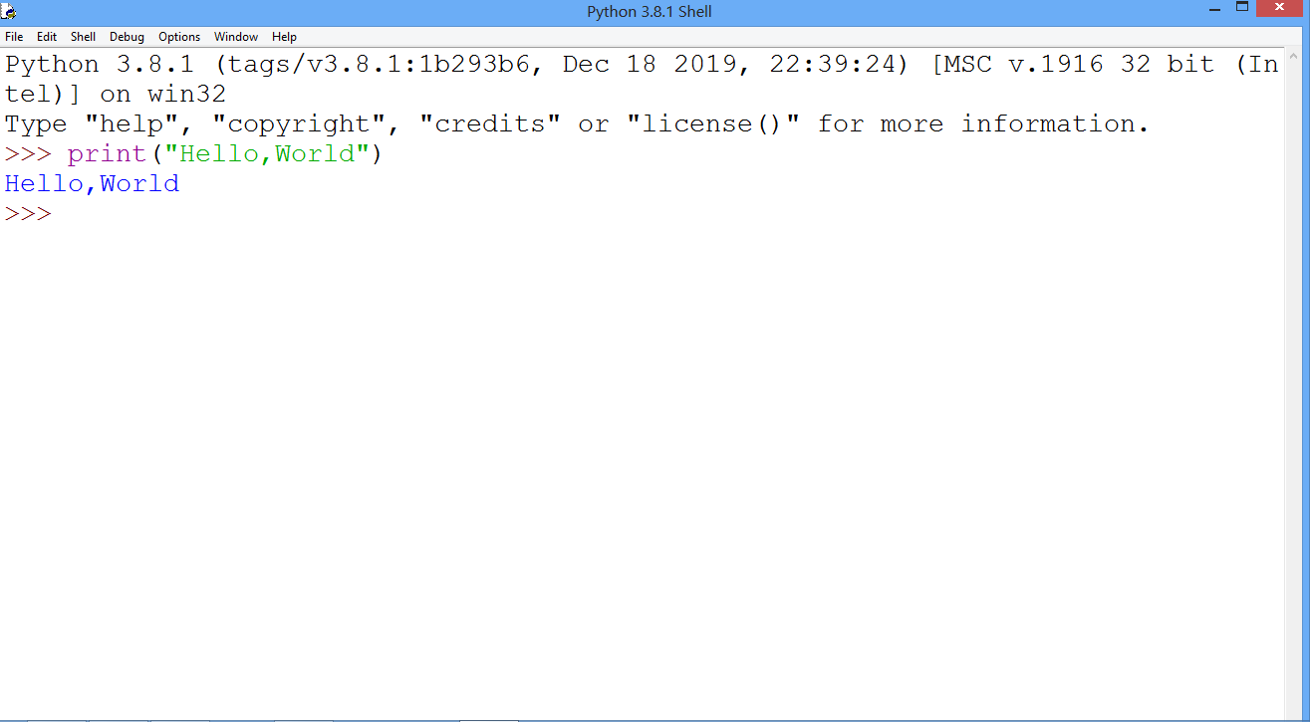
Basic Program

Slide 39
Data Types
Integer
Float
String
Boolean

Slide 40
Integer
a = 5
print(type(a))

Slide 41
Float
a = 5.6
print(type(a))

Slide 42
String
a = “Asif”
print(type(a))

Slide 43
Boolean
a = True
print(type(a))

Slide 44
Activity: What will be the output ?
a = “5”
b = 10
print(a+b)

Slide 45
What will be the result?
a = ‘2’
print(type(a))

Slide 46
What will be the result?
a = 2.6
print(type(a))

Slide 47
What will be the result?
a = 2.6.7
print(type(a))

Slide 48
Data Types
Text Type: Str
Numeric Types: int, float, complex
Sequence Types: list, tuple
Mapping Types: dict
Boolean Type: Bool

Slide 49
Types Casting
Type casting is used to convert one data type into another.
Example:
a = 2.6
print(type(a))
b = int(a)
print(type(b))

Slide 50
Types Casting
Example:
a = “2”
print(type(a))
b = int(a)
print(type(b))

Slide 51
Activity: What will be the output ?
a =“a”
b = 5.6.7
print(a+b)

Slide 52
Activity-01
Write a python program that takes two numbers and add them. Finally display the result.
Sample Output:
Enter first number: 2
Enter second number: 4
Addition result : 6

Slide 53
Activity-01 Solution
n1 = input("Enter first number:")
n2 = input("Enter second number:")
n1 = int(n1)
n2 = int(n2)
print("Addition result is:", n1+n2)

Slide 54
Activity-01 Optimized Solution
n1 = int(input("Enter first number:"))
n2 = int(input("Enter second number:"))
print("Addition result is:", n1+n2)

Slide 55
Activity-02
Write a python program that swap the values of variables.
Sample Output:
Before swapping
Value of a is: 5
Value of b is: 10
After swapping
Value of a is: 10
Value of b is: 5

Slide 56
Activity-02 Solution
a = 5
b = 10
print("Before swapping")
print("Value of a is:",a)
print("Value of b is:",b)
a = a + b
b = a – b
a = a – b
print("After swapping")
print("Value of a is:",a)
print("Value of b is:",b)

Slide 57
Activity-02 Optimized Solution
a = 5
b = 10
print("Before swapping")
print("Value of a is:",a)
print("Value of b is:",b)
a, b = b, a
print("After swapping")
print("Value of a is:",a)
print("Value of b is:",b)

Slide 58
Activity-03
Predict the outputs
x = “100”
y = 50
i. Predict the output.
Print(x + str(y))
ii. Predict the output
print(int(x) + y)
iii. Predict the output
print(float(x) * y)

Slide 59
Activity-03 Solution
Predict the outputs
x = “100”
y = 50
i. Predict the output.
Print(x + str(y))
Ouput: 10050

Slide 60
Activity-03 Solution
Predict the outputs
x = “100”
y = 50
ii. Predict the output
print(int(x) + y)
150

Slide 61
Activity-03 Solution
Predict the outputs
x = “100”
y = 50
iii. Predict the output
print(float(x) * y)
500.0

Slide 62
Operators
Arithematic Operators(+, -, *, /, %)
Assignment Operators(=,+=,-=,%=,) 3.Comparison Operators(==,!=,<,>,<=,>=) 4.Logical Operators(and, or, not)

Slide 63
Operators
1.Arithematic Operators(+, -, *, /, %)
a = 3
b = 4
result = a+b print(result)

Slide 64
Activity-04
1. Execute following statements
a = 10
b = 5
a%b =?
b%a = ? .

Slide 65
Activity-05
1. Execute following statements
a = ?
b = 11
a%b =2
What will be the value of a?

Slide 66
Random Task
?

Slide 67
Task-01
Write a program that converts grams into kilograms and kilograms into grams

Slide 68
Task-01 Solution
Write a program that converts grams into kilograms and kilograms into grams
Solution
grams = int(input("Enter grams: "))
kilograms = grams / 1000;
print("Kilograms are: ", kilograms)

Slide 69
Task-02
Write a program that converts meters into kilometers and kilometers into meters.

Slide 70
Task-02 Solutions
Write a program that converts meters into kilometers and kilometers into meters.
meters = int(input("Enter meters: "))
kilometers = meters / 1000;
print("Kilometers are: ", kilometers)

Slide 71
Task-03
Write a program that finds area of rectangle.

Slide 72
Task-03 Solution
Write a program that finds area of rectangle.
Solution:
l = int(input("Enter length: "))
w = int(input("Enter width: "))
area = l * w;
print(“Area of rectangle is: ", area)

Slide 73
Task-04
Write a program that finds area of square.

Slide 74
Task-04 Solution
Write a program that finds area of square.
Solution:
l = int(input("Enter length: "))
area = l * l;
print(“Area of Square is: ", area)

Slide 75
Task-05
Write a program that takes two input number and also it takes choice for operation like + or - . Finally perform the operations according to choice.

Slide 76
Task-05 Solution
Solution:
n1 = int(input("Enter first number: "))
n2 = int(input("Enter second number: "))
choice = input("Enter first number +, - :")
if choice == "+":
print("Addition result is:", n1 + n2)
if choice == "-":
print("Subtraction result is:", n1 - n2)

Slide 77
Thank you

Slide 78
Day-03 Input, Output, and String Formatting
By: Engr. Asif

Slide 79
Contents
How to take input from user?
How to display the result?
Working with variables
String data type
How to display string ?
String concatenation
String using f-string

Slide 80
How to take input from user ?

Slide 81
How to display the result?

Slide 82
Variable naming rules
Same rules like in other programming language.
Each variable should be start with upper or lower or underscore signe.
Each variable can contain upper or lower or undersocre or number or any other symbols.
Variable name cannot start with space.

Slide 83
Keyword or Reserve words
False | await | else | import | pass
None | break | except | in | raise
True | class | finally | is | return
and | continue | for | lambda | try
as | def | from | nonlocal | while
assert | del | global | not | with
async | elif | if | or | yield

Slide 84
String concatenation
It is used to combine string.
Example:
name = "Asif Ali“
city = "Daharki“
print("My name is,"+name+" my city is,"+city)
Sample Output:
My name is,Asif Ali my city is,Daharki

Slide 85
String data type
name = “Asif Ali”;
print(name);

Slide 86
Activity-01
Write a python that takes name, city, and country. Display the result.
Sample Output:
Enter your name: Asif Ali
Enter your city: Daharki
Enter your country: Pakistan
Hello, my name is Asif Ali my city is my country is Pakistan

Slide 87
String using f-string
f-string is used to display string with the variables.
Example:
name = "Asif Ali“
city = "Daharki“
print(f'Hello my is {name}, and my city is {city}')
Sample Output:
Hello my is Asif Ali, and my city is Daharki

Slide 88
Activity-02
Write a python that takes name, semester, department, and University. Display the result using f-string
Sample Output:
Enter your Name: Asif Ali
Enter your Semester: 2
Enter your Department: CSE
Enter your University: SIBAU
Hello, my name is Asif Ali, I am in semester 2, my department is CSE and my University is SIBAU

Slide 89
Activity-03: Write a python program that takes two numbers and perform addition, subtraction, multiplication, and division.
Enter any number: 10
Enter any number: 10
Sum: 20
Difference: 0
Product: 100
Division: 1

Slide 90
Activity-04: Write a python program that takes two numbers, your choice, and perform operation according to user’s choice.
Enter any number: 10
Enter any number: 10
Enter your choice: +, -, *, /
Your choice: +
Sum : 20

Slide 91
Thank you

